Slide 1
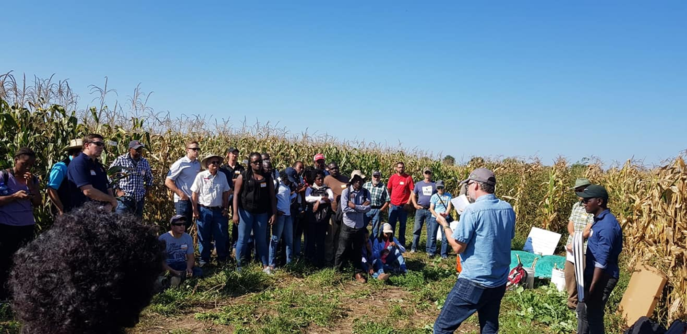
Using Machine Learning Algorithms to Predict the Probability of an Experimental Organic Hybrid to Outperform a Commercial Check
Introduction to Spatial Analytics
CPSC 444 : Final Project Presentation
Christopher Mujjabi - PhD Student - Crop Sciences

Slide 2
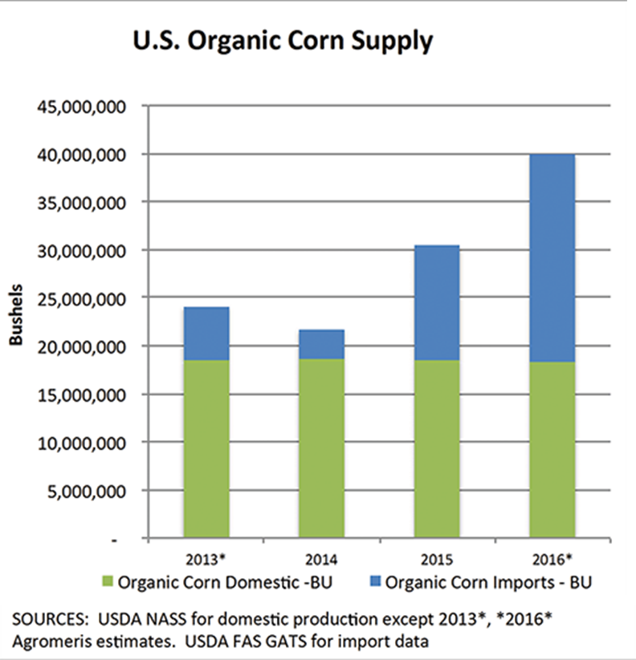
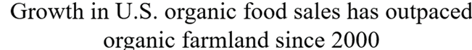
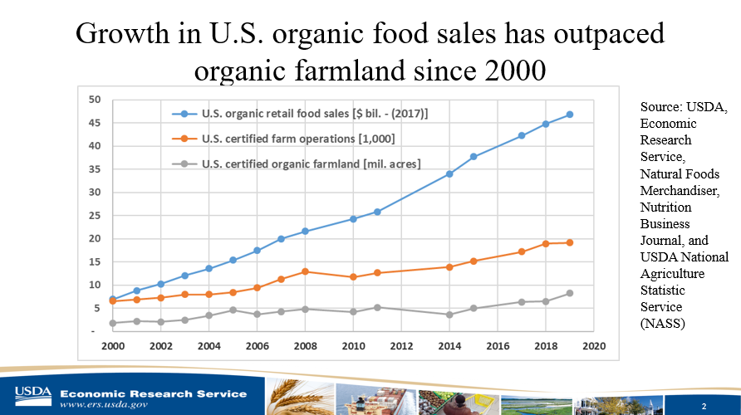
Introduction
U.S. organic market hit the record of $52.5B in sales
15000, Certified organic farms
5 million acres of U.S certified organic acreage (OTA,2019)
Demand has surpassed domestic supply
Increased importation of organic corn

Slide 3
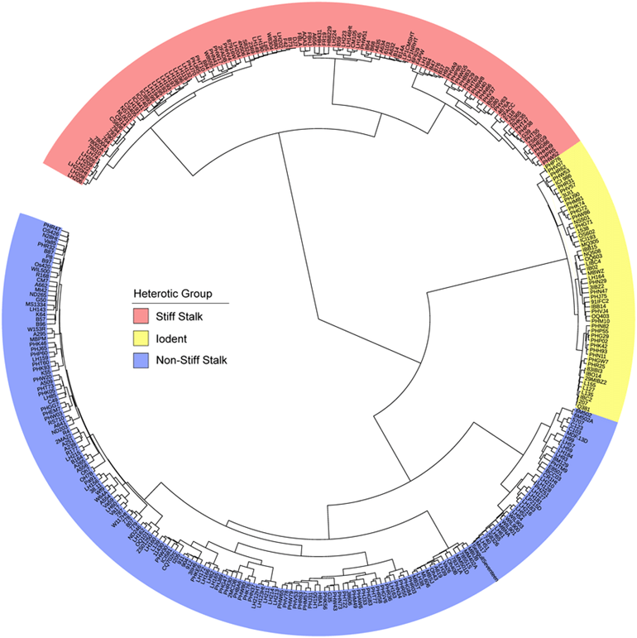
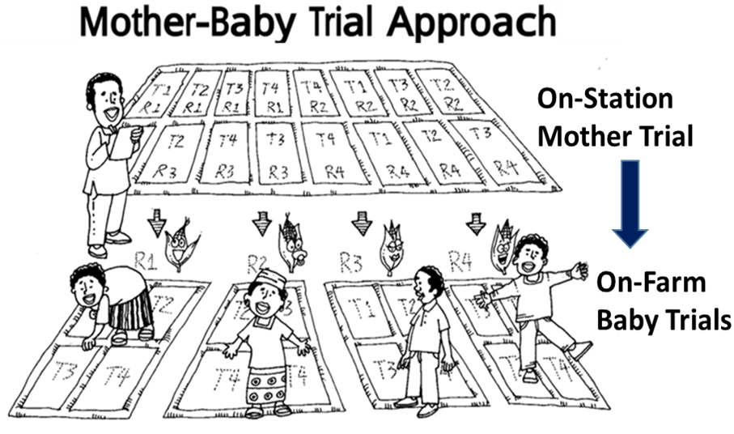
Participatory Breeding Using Variety Testing Networks
Over 460 exPVP maize inbred lines are currently available
750 additional lines will be added by 2028

Slide 4
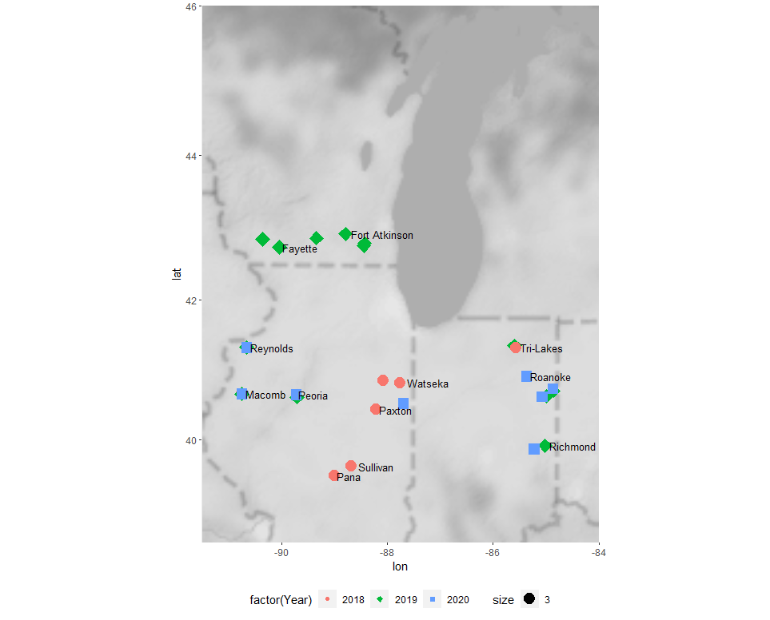


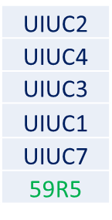
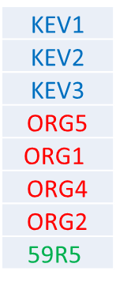


Variety Testing Network
Distribution of the Testing Network
2018
2019
2020
6 Farmers in Illinois
1 Farmer in Indiana
3 in Illinois
4 in Indiana (-1)
4 in Illinois
4 in Indiana (-1)
A total of 12 farmers have participated in the testing network
Breeding Programs
Mandaamin Inst. Organic
Montgomery Conventional
UIUC Bohn
ExPVP derived
Great Harvest Organic Check
A total of 12 hybrids and 1 check were tested

Slide 5
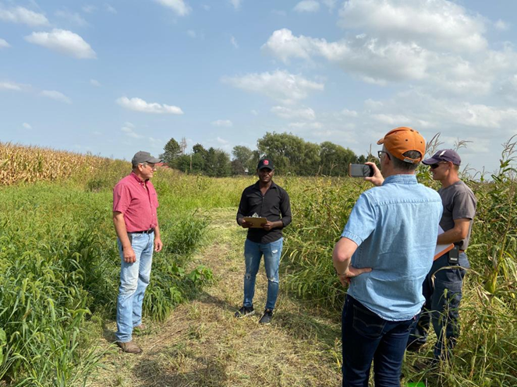
Project Objectives
Identify the environmental factors and agronomic management practices that were most influential to the performance of the experimental hybrids
Estimate the probability of each hybrid to outperform the commercial check using machine learning methods. ​
​

Slide 6
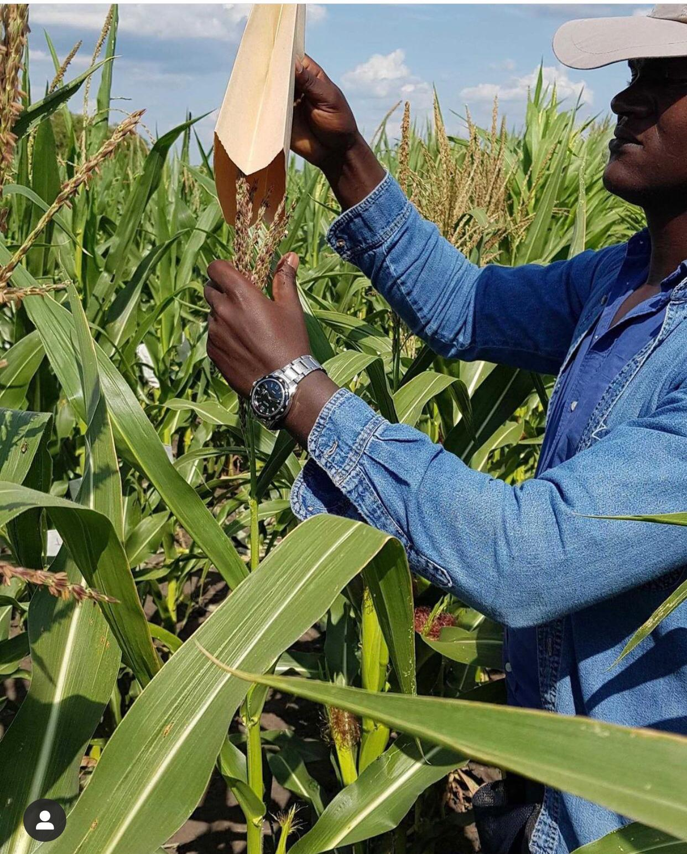
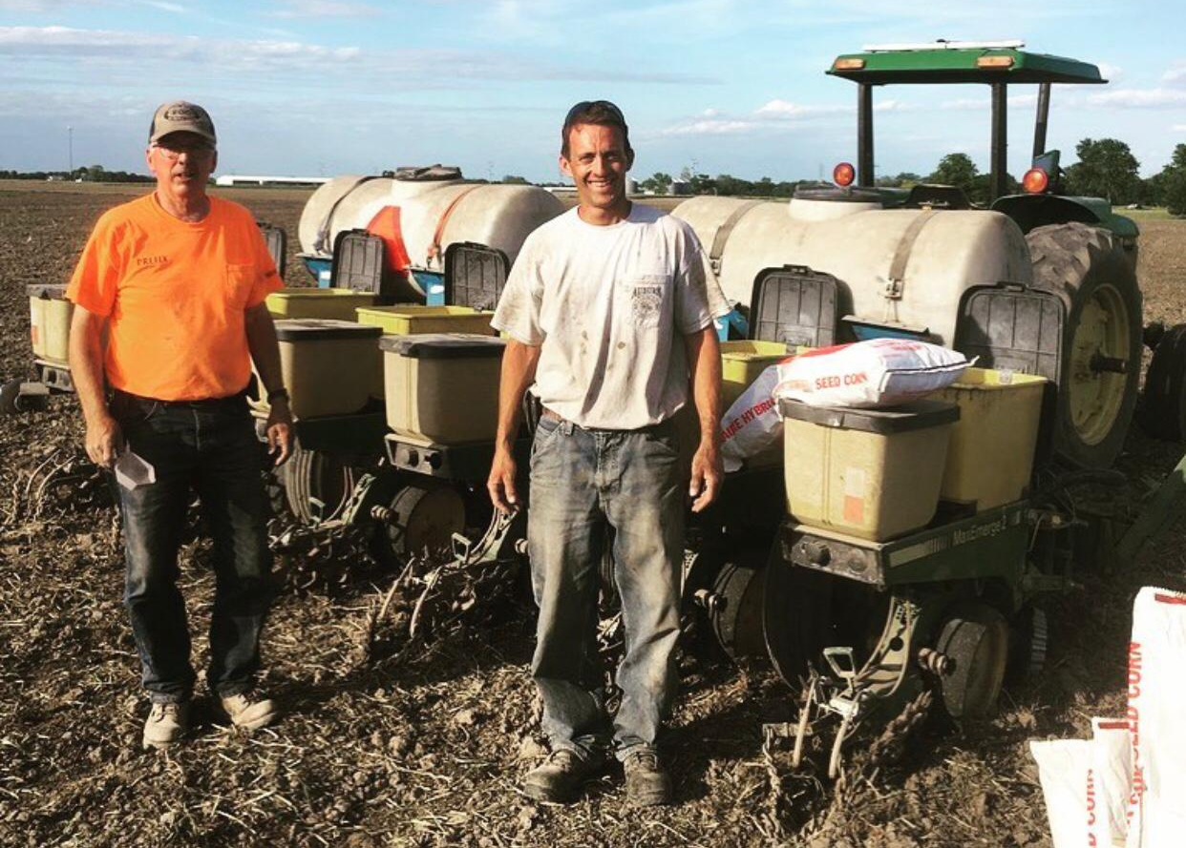
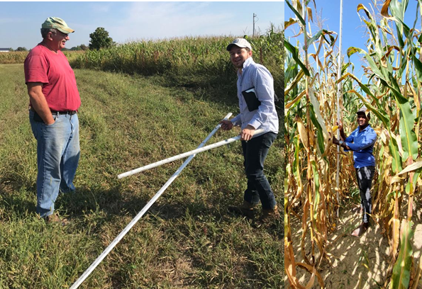
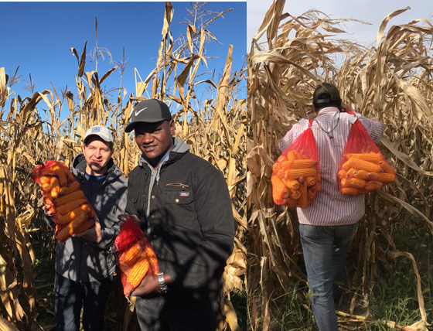
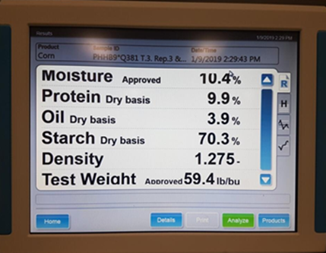
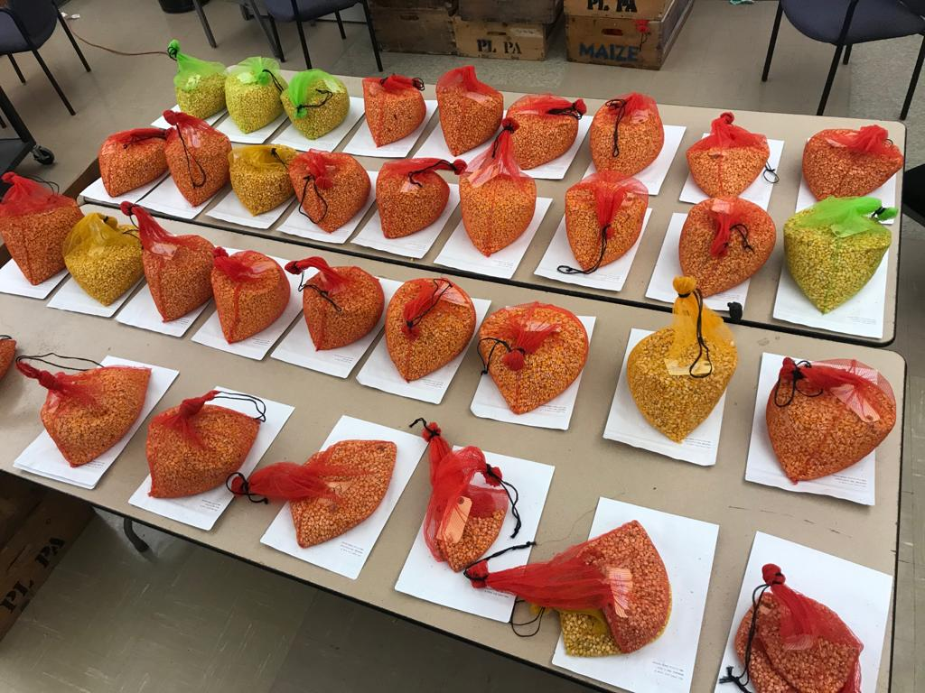
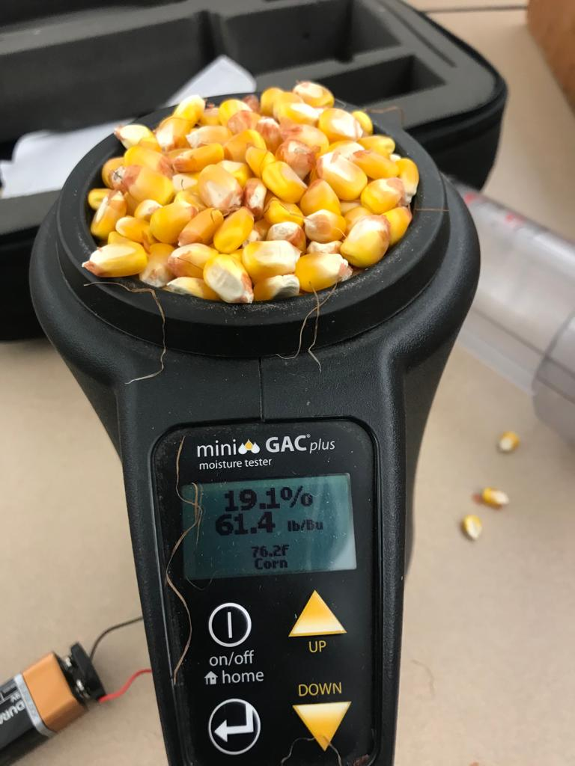
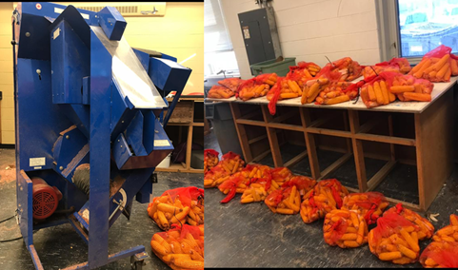
Materials and Methods
Seed Production
Organic Nursery
Farmer visits and Planting
Mail seed to farmers (8 hybrids)
4 row strips, 100 ft long (CRD)
Phenotyping
PHT, EHT and SD
Management practices
Harvesting
0.001 acres(17.5 ft )
2 sub samples per strip
Grain Analysis (NIR)
Protein, Oil and Starch
Samples for NIR
Yield Data
MST, TWT, GWT
Drying and Shelling

Slide 7
Dataset
Phenotypic Information
Soil Data
Weather Data
Management Data
Plant Height (cm)
Ear Height (cm)
Stem Diameters (mm)
Test Weight (lbs/bu)
Moisture (%)
Grain Yield (Bu/Acre)
Protein Content (%)
Starch Content (%)
Oil Content (%)
% Sand
%Clay
% Silt
CEC
pH
OM
P
Ca
Mg
K
Na
NO3 (Available N)
GPS Coordinates
Precipitation
Temperature
Min Temperature
Max Temperature
Solar Radiation
Planting Date
Manure Source
Planting Density
Cover Crop Type
Weed Management
Rotation Length
library(daymetr)

Slide 8
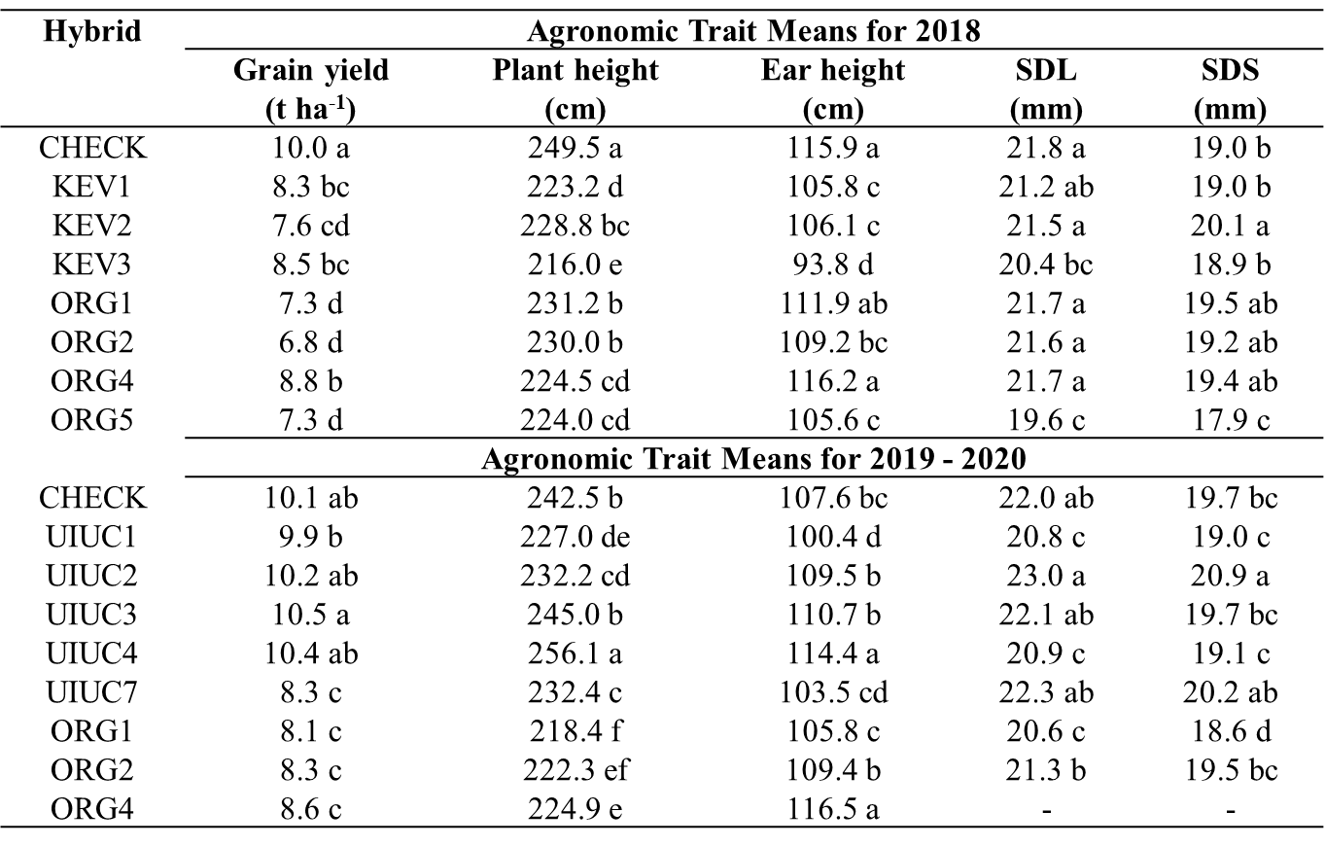
Statistical Analysis
Analysis of variance for the agronomic and grain quality traits

Slide 9
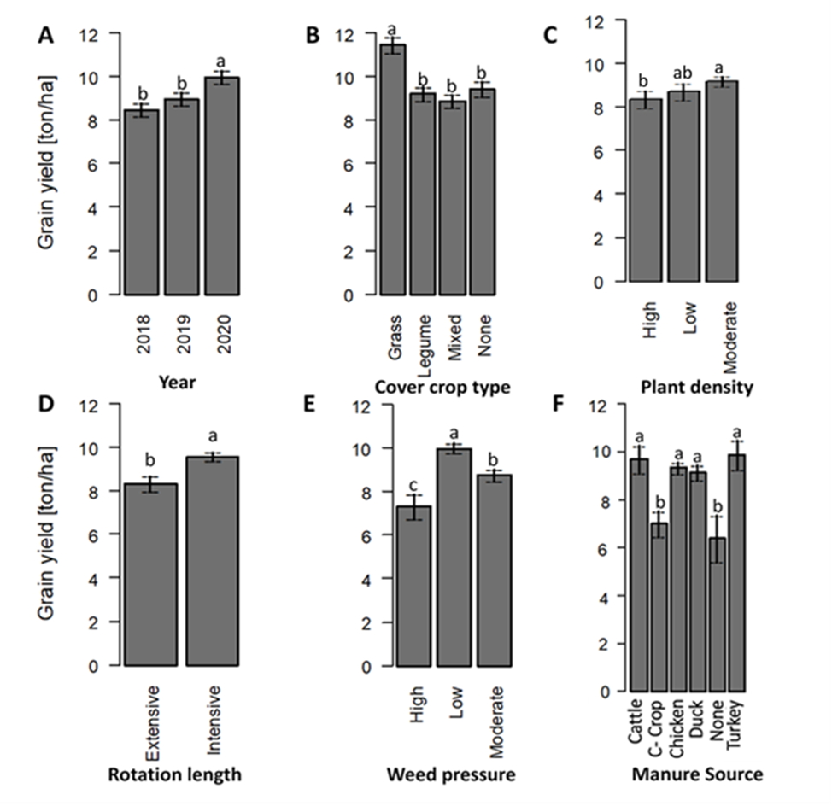
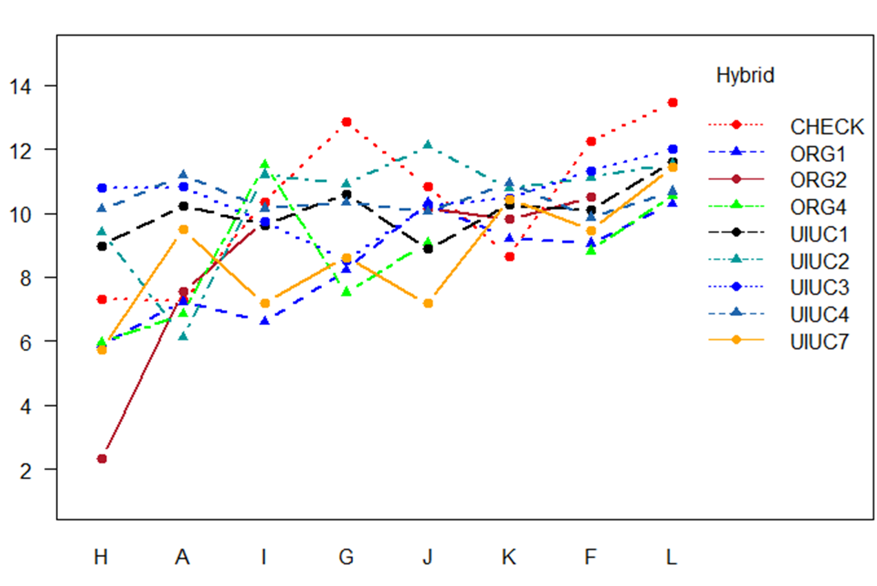
Effect of management practices on grain yield
Grain Yield [tons/acre]
Farmers

Slide 10
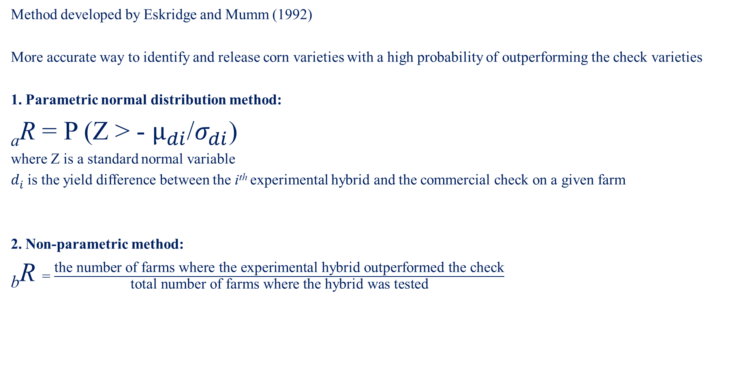
Traditional Reliability Estimation
Method developed by Eskridge and Mumm (1992)
More accurate way to identify and release corn varieties with a high probability of outperforming the check varieties
1. Parametric normal distribution method:
_{a}R = P (Z > - $μ_{di}$/$σ_{di}$)
where Z is a standard normal variable
$d_{i}$ is the yield difference between the i^{th} experimental hybrid and the commercial check on a given farm
2. Non-parametric method:
_{b}R = $\frac{\text{the} \text{number} \text{of} \text{farms} \text{where} \text{the} \text{experimental} \text{hybrid} \text{outperformed} \text{the} \text{check}}{\text{total} \text{number} \text{of} \text{farms} \text{where} \text{the} \text{hybrid} \text{was} \text{tested}}$

Slide 11

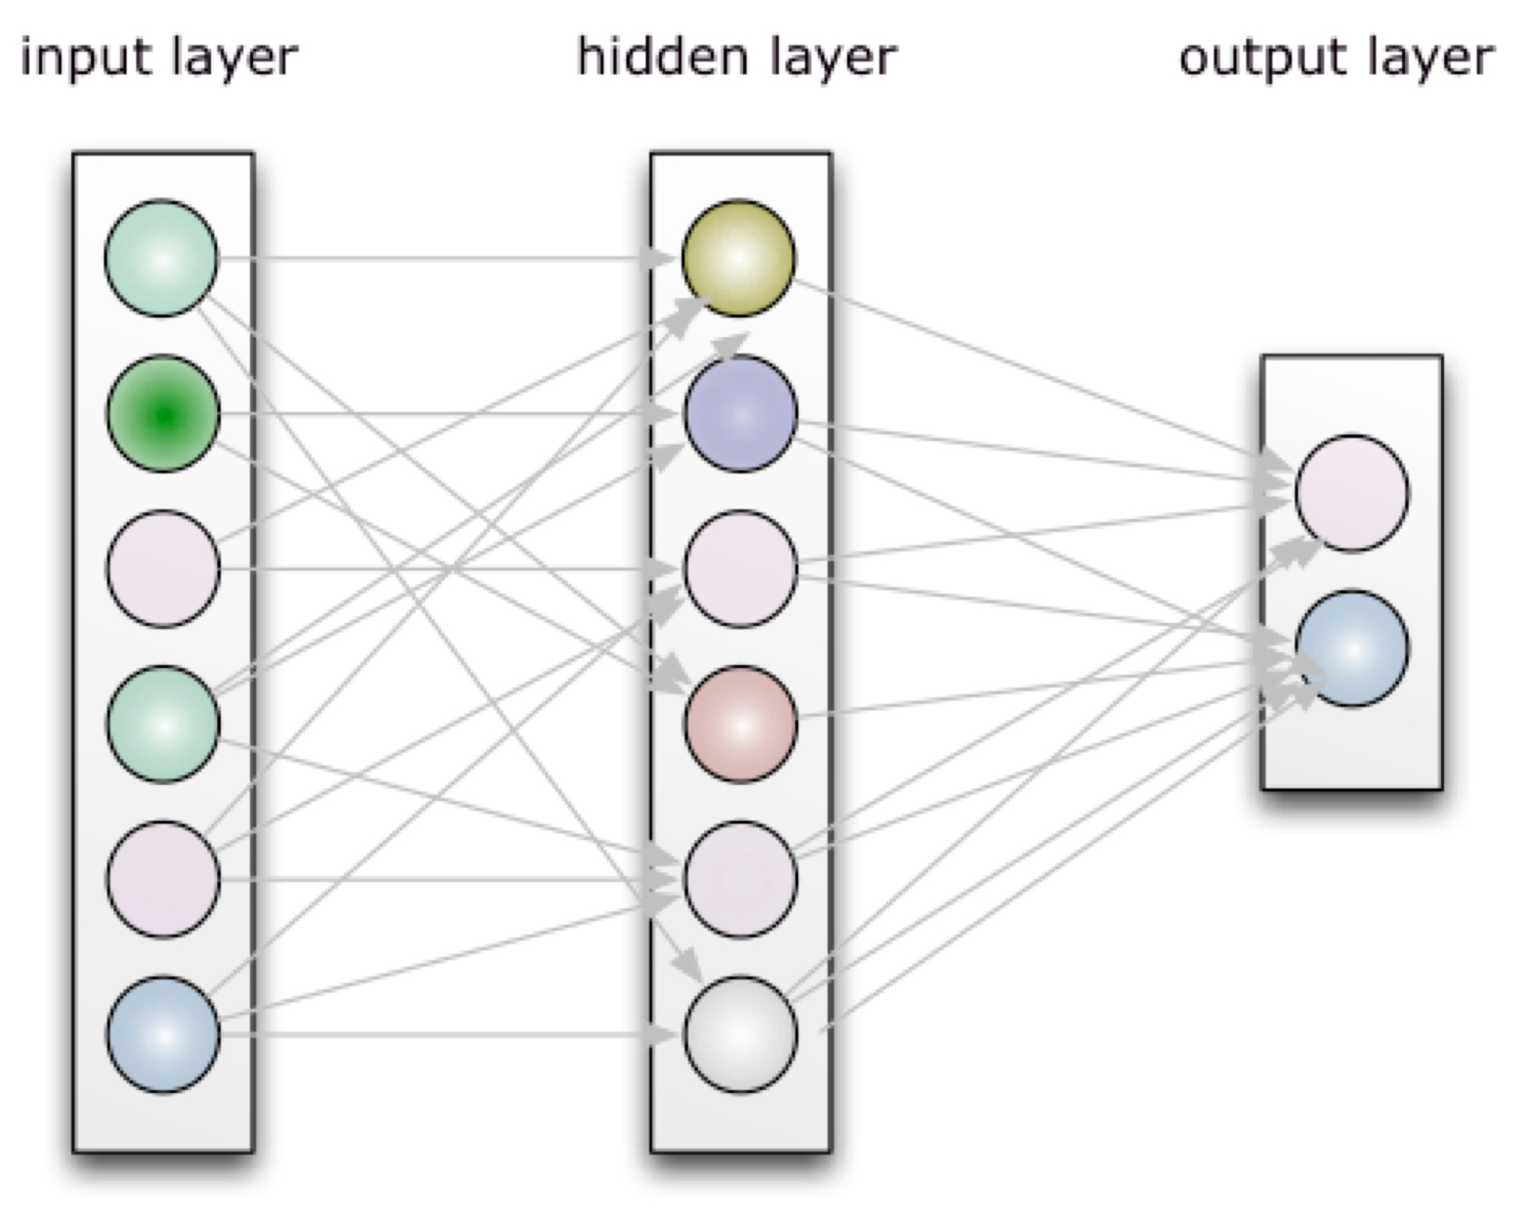
Using Machine Learning to Predict Reliability
Stepwise procedure using library(MASS)
Identify the Best fit model with the most important variables.
2. Using CART
The combined 3-year data will be divided into 80/20 Training and Testing sets
Classification tree – determine the influencing factors for reliability
Plot area under the curve
Estimate accuracy
3. Using Random Forest
Random forest model
Using different re-sampling methods (cv, bootstrapping etc)
4. Neural networks with packages keras and neuralnet
5. Compare the accuracies of the different prediction methods.

